Slide 1
Engineering Economy
Chapter 10: Evaluating Projects with the Benefit-Cost Ratio Method

Slide 2
The objective of Chapter 10 is to demonstrate the use of the benefit-cost ratio for the evaluation of public projects.

Slide 3
Public projects are unique in many ways.
Frequently much larger than private ventures
They may have multiple, varied purposes that sometimes conflict
Often very long project lives
Capital source is ultimately tax payers
Decisions made are often politically influenced
Benefits are often nonmonetary and are difficult to measure
more...

Slide 4
These elements make engineering economy studies more challenging.
The Flood Control Act of 1936 requires that benefits must exceed costs to justify federally funded projects, this is a criterion now used in most public projects.
There can be difficulty defining benefits, and even in establishing costs.

Slide 5
For any project, the proper perspective is to consider the net benefits to the owners of the enterprise.
For government projects, the owners are ultimately the taxpayers.
Benefits are favorable consequences of the project to the public (owners).
Costs represent monetary disbursements required of the government.
Disbenefits represent negative consequences of a project to the public (owners).

Slide 6
Self-liquidating projects are expected to repay their costs.
These projects generally provide utility services (power, water, toll roads, etc.).
They earn direct revenue that offset their costs, but they are not expected to earn profits or pay taxes.
In some cases in-lieu payments are made to governments in place of taxes and fees that would have been paid had it been under private ownership.

Slide 7
Cost allocations in multiple-purpose, public-sector projects tend to be arbitrary.
Some projects naturally have multiple purposes—e.g., construction of a dam.
Some of the costs incurred cannot properly be assigned to only one purpose.
Purposes may be in conflict.
Often support for a public project, and its many purposes, is politically sensitive.

Slide 8
Difficulties inherent in engineering economy studies in the public sector.
Profit standard not used to measure effectiveness
Monetary effect of many benefits is difficult to quantify
May be little or no connection between the project and the public (owners).
Often strong political influence whenever public funds are used, with little consideration to long-term consequences.

Slide 9
Difficulties inherent in engineering economy studies in the public sector.
Public projects are more subject to legal restrictions than private projects
The ability of governmental bodies to obtain capital is more restricted than that of private enterprise
The appropriate interest rate for discounting benefits and costs is often controversially and politically sensitive.

Slide 10
Selecting the interest rate to use in public projects is challenging.
Main considerations are
  the rate on borrowed capital,
  the opportunity cost of capital to the governmental agency, and
  the opportunity cost of capital to the taxpayers.
If money is borrowed specifically for a project, the interest rate on the borrowed capital is appropriate to use as the rate.

Slide 11
More interest rate considerations…
The 1997 Office of Management and Budget directive states that a 7% rate should be used, as an approximation of the return tax payers could earn from private investments.
Another idea is to use a market-determined risk-free rate, about 3-4% per year.
Bottom line: there is no simple formula, and it is an important policy decision at the discretion of the governmental agency.

Slide 12
Applying the benefit-cost ratio method
The consideration of the time value of money means this is really a ratio of discounted benefits to discounted costs.
Recommendations using the B-C ratio method will result in identical recommendations to those methods previously presented.
B-C ratio is the ratio of the equivalent worth of benefits to the equivalent worth of costs.

Slide 13
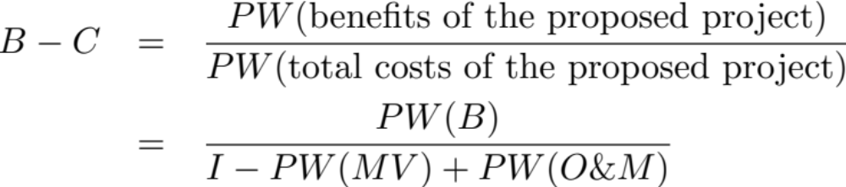
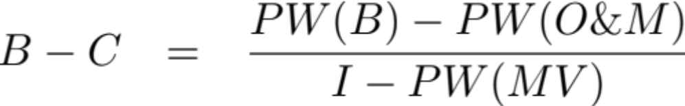
Two B-C ratios
Conventional B-C ratio with PW
Modified B-C ratio with PW
A project is acceptable when the B-C ratio is greater than or equal to one.

Slide 14
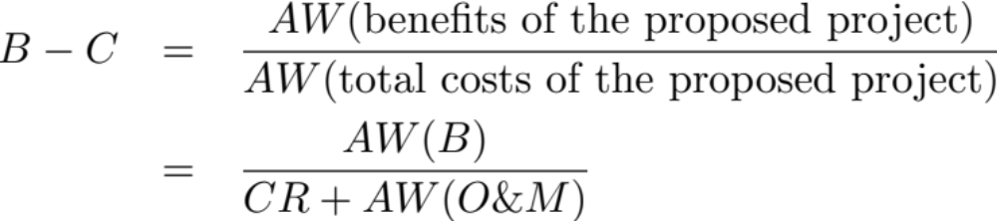
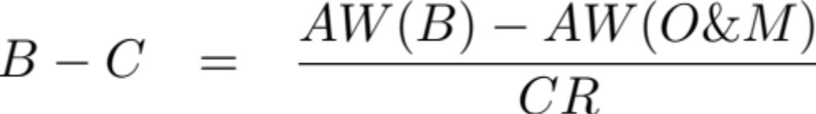
B-C ratios for annual worth.
Conventional B-C ratio with AW
Modified B-C ratio with AW

Slide 15
Pause and solve
Stillwater has initiated discussions on attracting rail service. A depot would need to be constructed, which would require $500,000 in land and $5.2 million in construction costs. Annual operating and maintenance costs for the facility would be $150,000, and personnel costs would be an additional $120,000. Other assorted costs would be born by the railroad and federal authorities. Annual benefits of the rail service are estimated as listed below.
$1,300,000 | Railroad annual payments
$200,000 | Rail tax charged to passengers
$180,000 | Convenience benefits to local residents
$120,000 | Additional tourism dollars for Stillwater
Apply the B-C ratio method, with a MARR of 8% per year and 20 year study period, to determine if the rail service should be established.

Slide 16
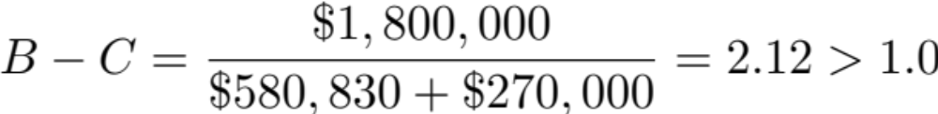
Solution
Annual benefits: $1,800,000
Annual O&M costs: $270,000
Capital Recovery: $5,700,000 (A/P, 8%,20) = $580,830
Since this value is 2.12, this is a good project for Stillwater to consider.

Slide 17
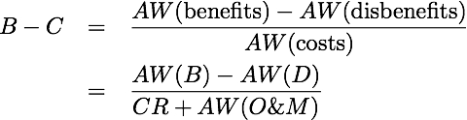
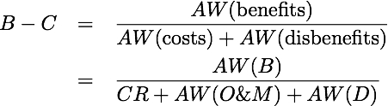
Disbenefits (D) can be included in the B-C ratio in either the numerator or denominator, as shown with AW below.
or

Slide 18
Added benefits vs. reduced cost
As with the different types of ratios, the question arises if classifying certain cash flows as either added benefits or reduced costs.
As before, while the numerical value of the ratio may change, there is no impact on project acceptability regardless of how the cash flows are handled.

Slide 19
Selecting projects
If projects are independent, all projects that have a B-C great than or equal to one may be selected.
For projects that are mutually exclusive, a B-C greater than one is required, but selecting the project that maximizes the B-C ratio does not guarantee that the best project is selected.

Slide 20
Incremental B-C analysis for mutually exclusive projects.
Incremental analysis must be used in the case of B-C and mutually exclusive projects.
Rank alternatives in order of increasing total equivalent worth of costs.
With “do nothing” as a baseline, begin with the lowest equivalent cost alternative and determine the incremental B-C ratio (ΔB/ΔC), selecting the alternative with the higher equivalent cost if the ratio is greater than one.

Slide 21
Which, if any, of the MEA projects below should be selected using B-C analysis? Assume a 20 year study period and MARR=10%.
 | A | B | C
Investment | $125,000 | $160,000 | $180,000
Annual O&M | 10,000 | 10,000 | 9,500
MV (20 yrs.) | 40,000 | 50,000 | 50,000
Benefit/yr. | 35,000 | 42,000 | 44,000
PW(10%)-costs | 204,190 | 237,703 | 253,447
PW(10%)-benefits | 297,975 | 357,570 | 374,597
B-C ratio | 1.46 | 1.50 | 1.47
Each alternative is attractive.

Slide 22
Incremental analysis
 | Δ(Β-A) | Δ(C-B)
Investment | $35,000 | $20,000
Annual O&M | 0 | -500
MV (20 yrs.) | 10,000 | 0
Benefits/yr. | 7,000 | 2,000
PW(10%)-costs | 33,514 | 15,743
PW(10%)-benefits | 59,595 | 17,027
B-C ratio | 1.78 | 1.08
Conclusion | B is better | C is better
Choose alternative C.

Slide 23
Pause and solve
Tempe is considering four mutually exclusive public-works projects. Their costs and benefits are presented in the table below. Each project has a useful life of 50 years and the MARR is 12% per year. Which of the projects, if any, should be selected?
 | A | B | C | D
Capital investment | $23,000,000 | $18,000,000 | $31,000,000 | $26,000,000
Annual op. and maint. cost | 1,800,000 | 1,200,000 | 2,100,000 | 2,000,000
Market value | 2,400,000 | 2,200,000 | 4,000,000 | 3,100,000
Annual benefit | 5,000,000 | 4,500,000 | 6,500,000 | 5,800,000

Slide 24
Solution
Tempe is considering four mutually exclusive public-works projects. Their costs and benefits are presented in the table below. Each project has a useful life of 50 years and the MARR is 12% per year. Which of the projects, if any, should be selected?
 | A | B | C | D
Capital investment | $23,000,000 | $18,000,000 | $31,000,000 | $26,000,000
Annual op. and maint. cost | 1,800,000 | 1,200,000 | 2,100,000 | 2,000,000
Market value | 2,400,000 | 2,200,000 | 4,000,000 | 3,100,000
Annual benefit | 5,000,000 | 4,500,000 | 6,500,000 | 5,800,000

Slide 25
Some criticisms of B-C analysis.
B-C is often used as an “after-the-fact” justification tool.
Distributional inequities (one group benefits, another pays the cost) may not be accounted for.
Qualitative information is often ignored.
Bottom line: these are largely reflective of the inherent difficulties in evaluating public projects rather than the B-C method itself.

